Slide 1
The convergence of the Regula Falsi Method
Name: Abhirup Bag Department: CSE-B Roll number: 13000122082 Subject: Numerical Methods Subject Code: OEC-IT601A

Slide 2
content
Introduction
Derivation/Formulation and geometrical interpretation
Convergence Analysis
Error Analysis
Application And Implementation
References
3
4 – 6
7-13
14
15 - 18
19

Slide 3
Introduction
The Regula Falsi Method, also known as the False Position Method, is a numerical approach used to determine the roots of a non-linear equation, represented as f(x) = 0.
This method involves selecting two initial estimates, a₀ and b₀, such that the function values at these points have opposite signs, which suggests the presence of a root within that interval. It operates on the premise that if a continuous function crosses zero within an interval, there must be a root located somewhere in that span. Compared to the bisection method, this method offers quicker convergence, but it is not as fast as the Newton-Raphson Method.
The Regula Falsi Method is particularly effective for continuous functions when a root is situated between two specific points.

Slide 4
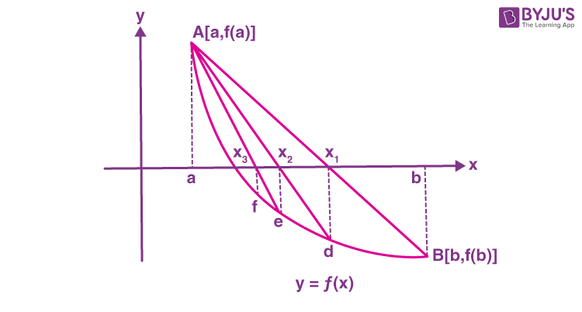

Derivation/Formulation and geometrical interpretation
Let us consider an equation f(x)=0 with graphical representation as,
Now, let α be a real root of the equation y = f(x) = 0, so clearly f(α) = 0.
$$α$$

Slide 5
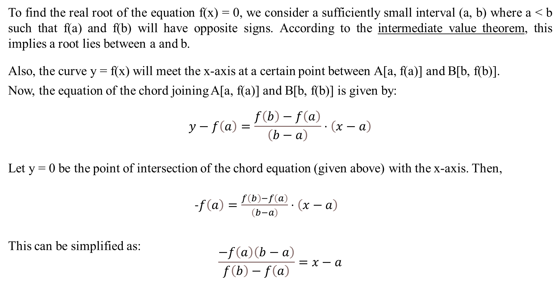
To find the real root of the equation f(x) = 0, we consider a sufficiently small interval (a, b) where a < b such that f(a) and f(b) will have opposite signs. According to the intermediate value theorem, this implies a root lies between a and b.
Also, the curve y = f(x) will meet the x-axis at a certain point between A[a, f(a)] and B[b, f(b)].
Now, the equation of the chord joining A[a, f(a)] and B[b, f(b)] is given by:
$$y−f\left(a\right)=\frac{f\left(b\right)−f\left(a\right)}{\left(b−a\right)}⋅\left(x−a\right)$$
Let y = 0 be the point of intersection of the chord equation (given above) with the x-axis. Then,
-$f\left(a\right)=\frac{f\left(b\right)−f\left(a\right)}{\left(b−a\right)}⋅\left(x−a\right)$
This can be simplified as:
$$\frac{−f\left(a\right)\left(b−a\right)}{f\left(b\right)−f\left(a\right)}=x−a$$

Slide 6
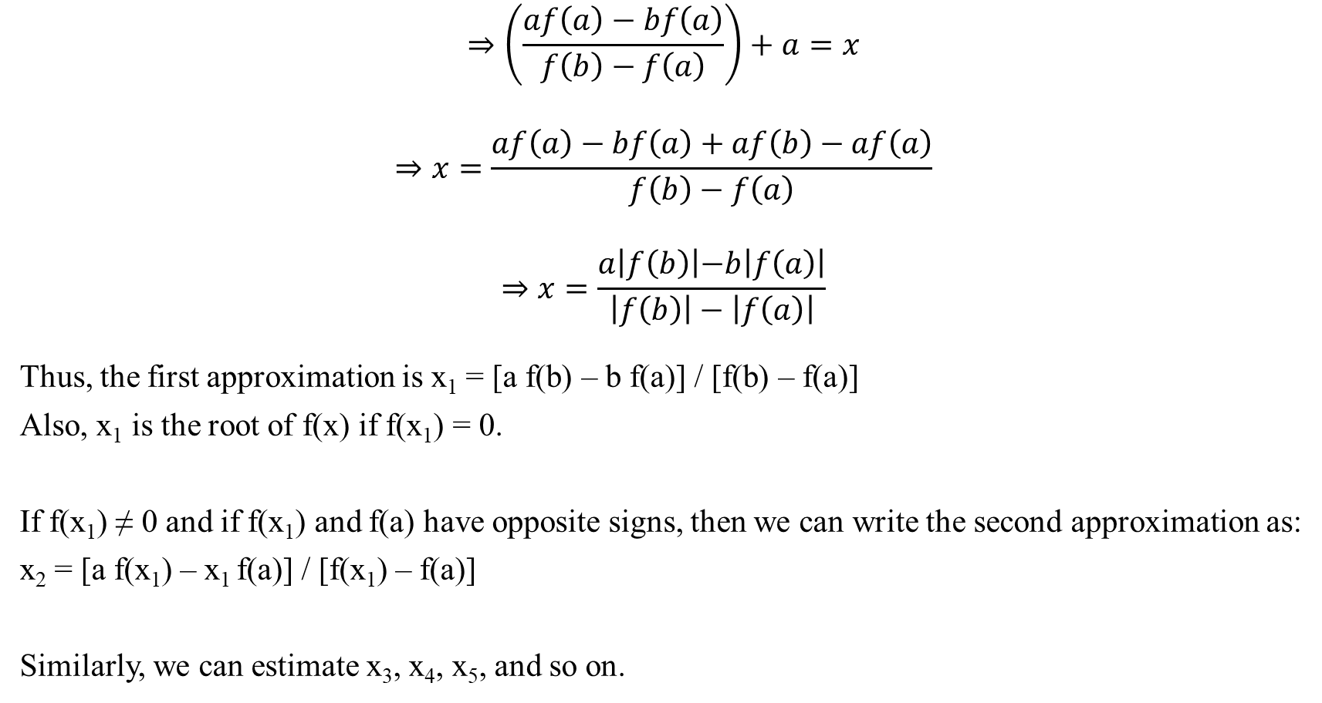
$$⇒\left(\frac{af\left(a\right)−bf\left(a\right)}{f\left(b\right)−f\left(a\right)}\right)+a=x$$
$$⇒x=\frac{af\left(a\right)−bf\left(a\right)+af\left(b\right)−af\left(a\right)}{f\left(b\right)−f\left(a\right)}$$
$$⇒x=\frac{a\left|f\left(b\right)\left|−b\right|f\left(a\right)\right|}{\left|f\left(b\right)\right|−\left|f\left(a\right)\right|}$$
Thus, the first approximation is x₁ = [a f(b) – b f(a)] / [f(b) – f(a)]
Also, x₁ is the root of f(x) if f(x₁) = 0.
If f(x₁) ≠ 0 and if f(x₁) and f(a) have opposite signs, then we can write the second approximation as:
x₂ = [a f(x₁) – x₁ f(a)] / [f(x₁) – f(a)]
Similarly, we can estimate x₃, x₄, x₅, and so on.

Slide 7

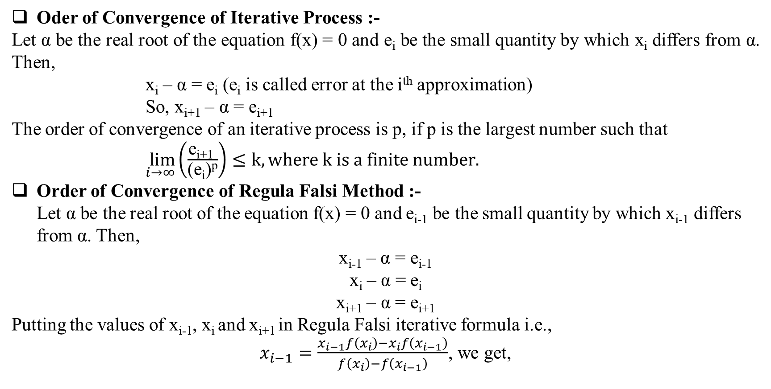
Convergence Analysis
Oder of Convergence of Iterative Process :-
Let α be the real root of the equation f(x) = 0 and e_{i} be the small quantity by which x_{i} differs from α. Then,
x_{i} – α = e_{i} (e_{i} is called error at the i^{th} approximation)
So, x_{i+1} – α = e_{i+1}
The order of convergence of an iterative process is p, if p is the largest number such that
$\lim_{i→∞}\left(\frac{\text{e}\text{i}\text{+1 }}{\text{(}\text{ei}\text{)}\text{p}}\right)≤k, where k is a finite number.$
Order of Convergence of Regula Falsi Method :- Let α be the real root of the equation f(x) = 0 and e_{i-1} be the small quantity by which x_{i-1} differs from α. Then,
x_{i-1} – α = e_{i-1} x_{i} – α = e_{i} x_{i+1} – α = e_{i+1}
Putting the values of x_{i-1}, x_{i} and x_{i+1} in Regula Falsi iterative formula i.e.,
$x_{i−1}=\frac{x_{i−1}f\left(x_{i}\right)−x_{i}f\left(x_{i−1}\right)}{f\left(x_{i}\right)−f\left(x_{i−1}\right)}$, we get,
$$\}$$

Slide 8
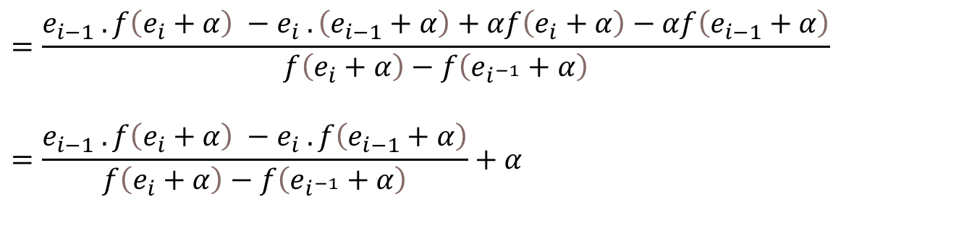


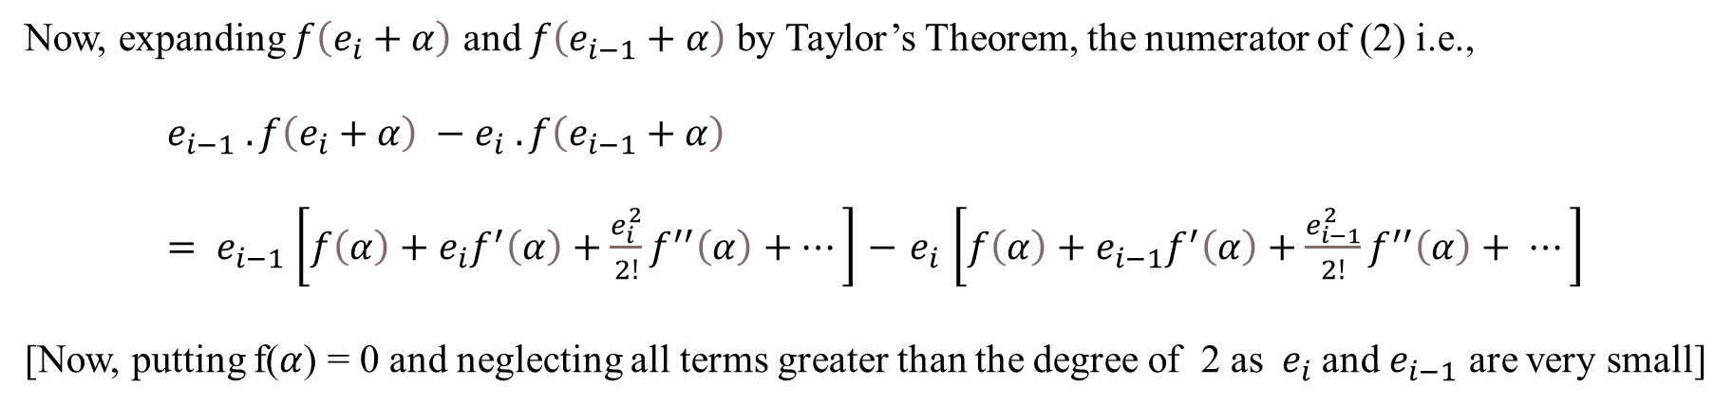
$$e_{i+1}+α= \frac{\left(e_{i−1}+α\right)f\left(e_{i}+α\right)−\left(e_{i}+α\right)f\left(e_{i−1}+α\right)}{f\left(e_{i}+α\right)−f\left(e_{i^{−1}}+α\right)}$$
$$e_{i+1}=\frac{e_{i−1} .f\left(e_{i}+α\right) −e_{i} .f\left(e_{i−1}+α\right)}{f\left(e_{i}+α\right)−f\left(e_{i^{−1}}+α\right)}$$
$$=\frac{e_{i−1} .f\left(e_{i}+α\right) −e_{i} .\left(e_{i−1}+α\right)+αf\left(e_{i}+α\right)−αf\left(e_{i−1}+α\right)}{f\left(e_{i}+α\right)−f\left(e_{i^{−1}}+α\right)}$$
$$=\frac{e_{i−1} .f\left(e_{i}+α\right) −e_{i} .f\left(e_{i−1}+α\right)}{f\left(e_{i}+α\right)−f\left(e_{i^{−1}}+α\right)}+α$$
$$⇒$$
……… (2)
Now, expanding $f\left(e_{i}+α\right)$ and $f\left(e_{i−1}+α\right)$ by Taylor’s Theorem, the numerator of (2) i.e.,
$$e_{i−1} .f\left(e_{i}+α\right) −e_{i} .f\left(e_{i−1}+α\right)$$
$= e_{i−1}$ $\left[f\left(α\right)+e_{i}f^{′}\left(α\right)+\frac{e_{i}^{2}}{2!}f^{′′}\left(α\right)+⋯\right]$ $−{ e}_{i} \left[f\left(α\right)+e_{i−1}f^{′}\left(α\right)+\frac{e_{i−1}^{2}}{2!}f^{′′}\left(α\right)+ ⋯\right]$
[Now, putting f($α$) = 0 and neglecting all terms greater than the degree of 2 as ${ e}_{i}$and $e_{i−1}$ are very small]

Slide 9
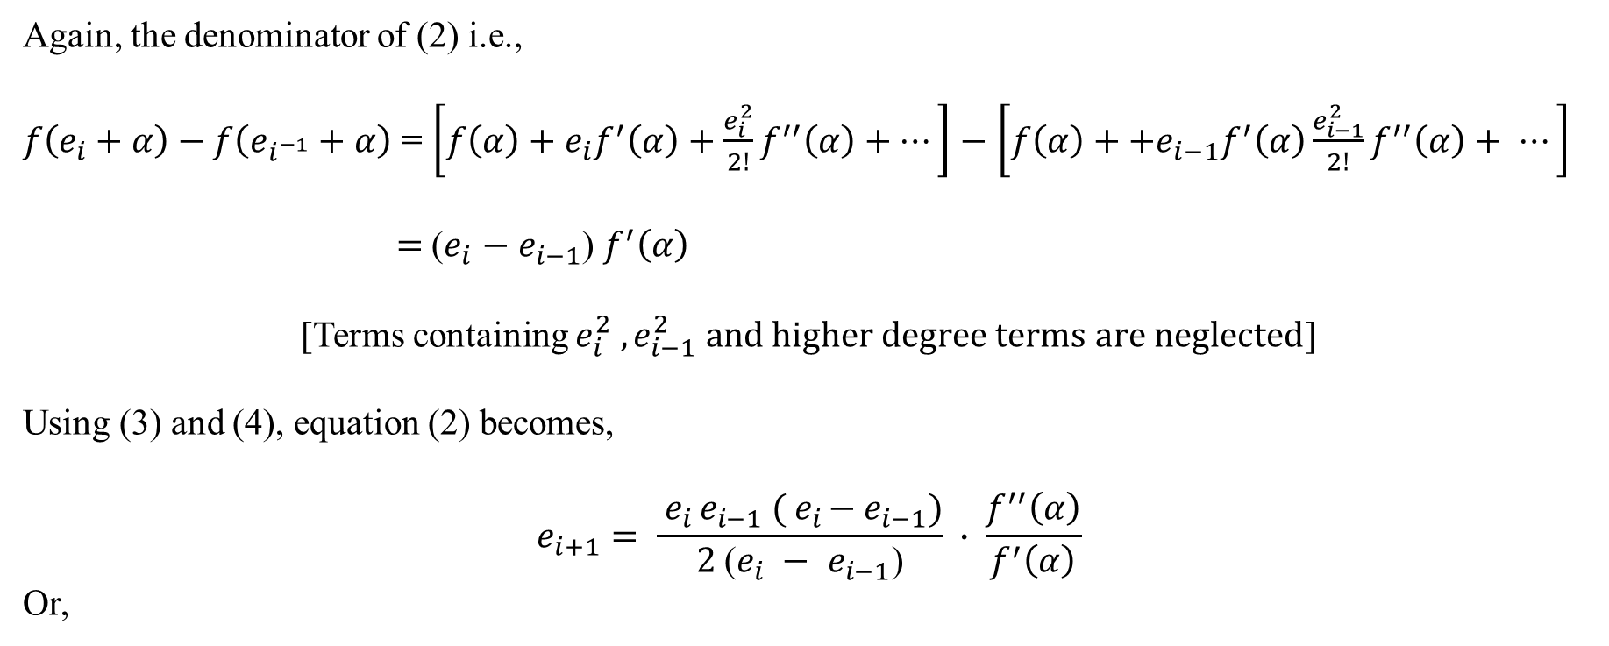
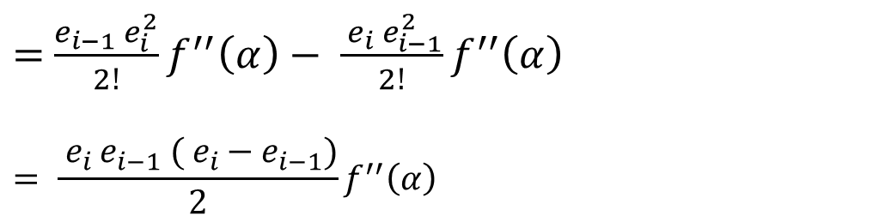


$=$ $\frac{e_{i−1} e_{i}^{2}}{2!}f^{′′}\left(α\right)− \frac{{ e}_{i}{ e}_{i−1}^{2}}{2!}f^{′′}\left(α\right)$
$$= \frac{{ e}_{i }e_{i−1} ({ e}_{i }{− e}_{i−1})}{2}f^{′′}\left(α\right)$$
$$⋯⋯⋯\left(3\right)$$
Again, the denominator of (2) i.e.,
$f\left(e_{i}+α\right)−f\left(e_{i^{−1}}+α\right)$ = $\left[f\left(α\right)+e_{i}f^{′}\left(α\right)+\frac{e_{i}^{2}}{2!}f^{′′}\left(α\right)+⋯\right]$ $−$ $\left[f\left(α\right)++e_{i−1}f^{′}\left(α\right)\frac{e_{i−1}^{2}}{2!}f^{′′}\left(α\right)+ ⋯\right]$
$=$ ($e_{i}$ $−$ $e_{i−1}$) $f^{′}\left(α\right)$
[Terms containing $e_{i}^{2} , e_{i−1}^{2} and higher degree terms are neglected$]
Using (3) and (4), equation (2) becomes,
$$e_{i+1}= \frac{{ e}_{i }e_{i−1} ({ e}_{i }{− e}_{i−1})}{2 \text{(}e_{i} − e_{i−1}\text{)}} ∙ \frac{f^{′′}\left(α\right)}{f^{′}\left(α\right)}$$
Or,
$$⋯⋯⋯\left(4\right)$$

Slide 10




$$e_{i+1}= \frac{{ e}_{i } . { e}_{i−1}}{2} ∙ \frac{f^{′′}\left(α\right)}{f^{′}\left(α\right)} =c_{i−1}⋅e_{i}⋅k$$
Where $k=\frac{f^{′′}\left(α\right)}{2f^{′}\left(α\right)}$ is a finite constant.
Let p be the order of convergence, then $\frac{{ e}_{i−1}}{e_{i}^{p}} = k^{′}$ , where $k^{′}$ is finite.
Or,
$$e_{i+1}=k^{′}e_{i}^{p}$$
And,
$$e_{i}=k^{′}e_{i−1}^{p}$$
Or,
$$e_{i−1}={\left[\frac{e_{i}}{k^{′}}\right]}^{\frac{1}{p}}$$
Putting the values of ${ e}_{i+1}$and $e_{i−1}$ in (5), we get
$$⋯⋯⋯\left(5\right)$$
$$⋯⋯⋯\left(6\right)$$
$$⋯⋯⋯\left(7\right)$$

Slide 11

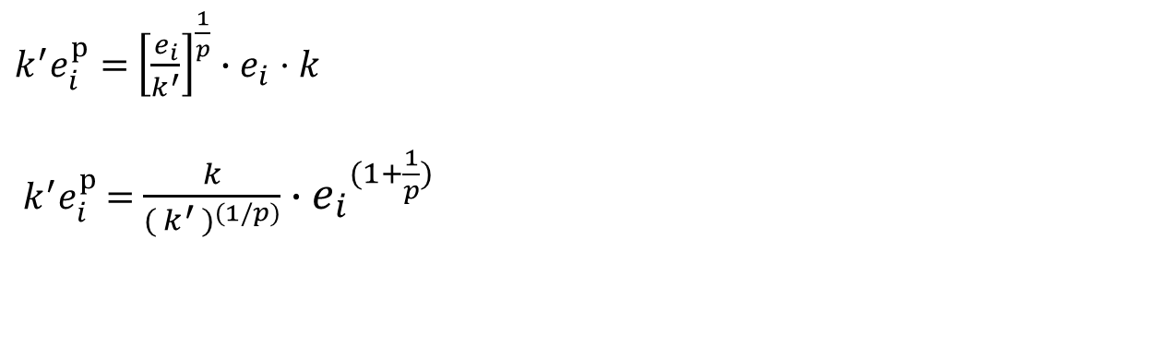
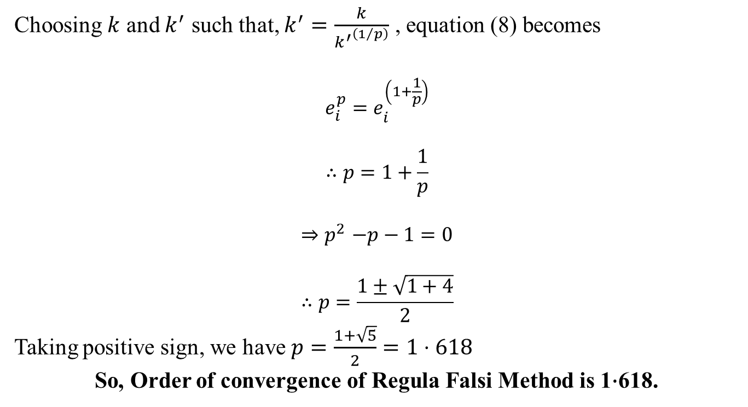

$k^{′}e_{i}^{p}=$ ${\left[\frac{e_{i}}{k^{′}}\right]}^{\frac{1}{p}}$ $∙e_{i}⋅k$
$k^{′}e_{i}^{p}$ = $\frac{k}{{{( k}^{′ })}^{(1/p)}}{ ∙e_{i}}^{(1+\frac{1}{p})}$
$$⇒$$
$$⋯⋯⋯\left(8\right)$$
Choosing $k$ and $k^{′}$ such that, $k^{′}=\frac{k}{{k^{′}}^{\left(1/p\right)}}$ , equation (8) becomes
$$e_{i}^{p}=e_{i}^{\left(1+\frac{1}{p}\right)}$$
$$∴p=1+\frac{1}{p}$$
$${⇒p}^{2}−p−1=0$$
$$∴p=\frac{1±\sqrt{1+4}}{2}$$
Taking positive sign, we have $p=\frac{1+\sqrt{5}}{2}=1⋅618$
So, Order of convergence of Regula Falsi Method is 1$∙$618.

Slide 12
Key Points :-
The method is at least linearly convergent, meaning the error reduces proportionally in each iteration.
In some cases, it can be super-linearly convergent (faster than linear but slower than quadratic).
However, in cases where one side of the interval remains fixed (i.e., if the function is nearly flat on one side), the convergence can become extremely slow.
Slow Convergence Issue :-
If one endpoint remains unchanged for multiple iterations, the newly computed points keep getting closer to the root but at a decreasing rate.
This happens when the function is asymmetric or nearly tangent to the x-axis at one endpoint, causing Regula Falsi to behave inefficiently compared to methods like the secant method or Newton’s method.

Slide 13
Modifications to Improve Convergence
To address slow convergence, variations have been developed:
Illinois Algorithm
If the same endpoint remains fixed, it reduces its weight by half.
This forces the interval to update more dynamically, accelerating convergence.
Anderson-Björck Method
Adjusts the secant approximation to avoid stagnation.
Modifications Using Dynamic Weighting
Introduce factors that adjust weights dynamically based on function values.

Slide 14
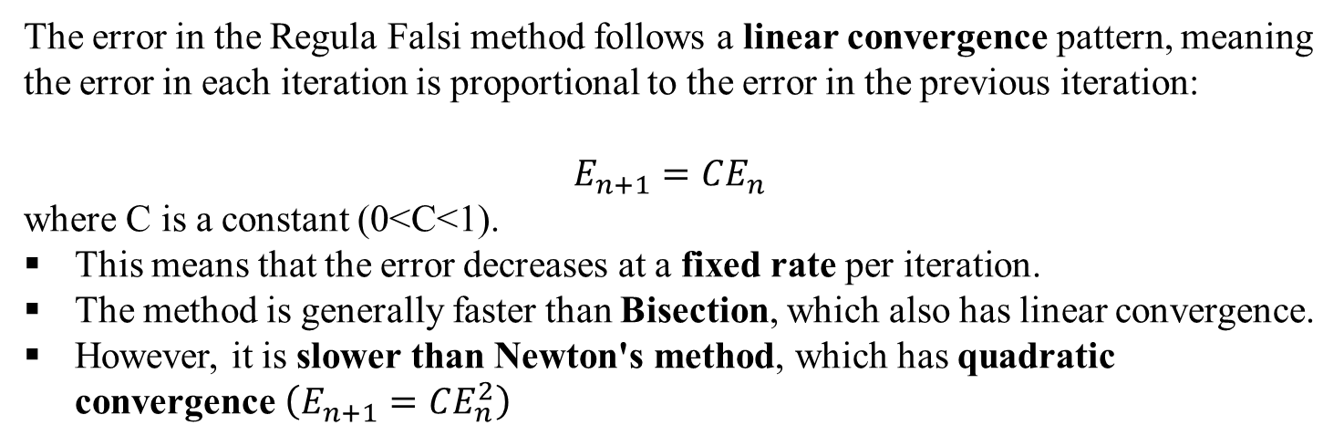
Error Analysis
The error in the Regula Falsi method follows a linear convergence pattern, meaning the error in each iteration is proportional to the error in the previous iteration:
$$E_{n+1}=CE_{n}$$
where C is a constant (0<C<1).
This means that the error decreases at a fixed rate per iteration.
The method is generally faster than Bisection, which also has linear convergence.
However, it is slower than Newton's method, which has quadratic convergence $\left(E_{n+1}=CE_{n}^{2}\right)$

Slide 15
Application And Implementation
Applications :-
The Regula Falsi (False Position) method is widely used in engineering, physics, finance, and other fields where root-finding is required. Some common applications include:
Engineering Applications
Electrical Engineering: Used in circuit analysis to find operating points (e.g., solving nonlinear equations in transistor circuits).
Mechanical Engineering: Applied in stress-strain analysis, vibration analysis, and fluid mechanics problems.
Civil Engineering: Used in structural analysis and load distribution calculations.
Physics Applications
Quantum Mechanics: Used in solving Schrödinger's equation for energy eigenvalues.
Classical Mechanics: Applied in solving projectile motion equations with drag forces.
Thermodynamics: Used in heat transfer calculations, such as solving radiation and conduction equations.

Slide 16
Mathematical and Computational Applications
Root-finding Problems: Used when an equation cannot be solved algebraically.
Numerical Analysis: Serves as a benchmark for comparing root-finding methods.
Finance and Economics Interest
Rate Calculations: Helps in determining the internal rate of return (IRR).
Risk Analysis: Used in models predicting market trends based on mathematical equations.

Slide 17
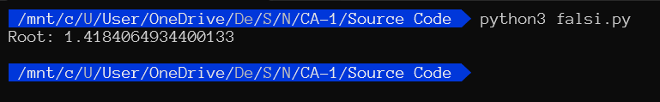
Code Implementation In Python And Output :-
import math
def regula_falsi(f, a, b, tol=1e-6, max_iter=100):
if f(a) * f(b) >= 0:
raise ValueError("Root is not bracketed. Choose different a and b.")
for i in range(max_iter):
c = b - (f(b) * (b - a)) / (f(b) - f(a)) # Secant formula
if abs(f(c)) < tol: # Check convergence
return c
if f(a) * f(c) < 0: # Root lies between a and c
b = c
else: # Root lies between c and b
a = c
return c # Return last approximation
# Define the function
def f(x):
return math.log10(x) – cos(x);
a = 1 # Initial guesses
b = 2
root = regula_falsi(f, a, b)
print("Root:", root)

Slide 18
Worked Out Example :-
Let us consider an equation, f(x) = $\log_{10}^{x}{−\cos{x}}$. Now we need to compute a real root of this equation using Regula Falsi Method correct up to 3 decimal places.
x | 1 | 2
f(x) | -0.5403 | 0.71718
So, f(1) f(2) < 0, hence Initial guess interval : (a₀ , b₀) = (1 , 2)
n | a_{n} (-ve) | b_{n} (+ve) | f(a_{n}) | f(b_{n}) | x_{n+1} | f(x_{n+1})
0 | 1 | 2 | -0.54030 | 0.71718 | 1.42967 | 0.01458
1 | 1 | 1.42967 | -0.54030 | 0.01458 | 1.41838 | -0.00003
2 | 1.41838 | 1.42967 | -0.00003 | 0.01458 | 1.41841 | −0.000008
3 | 1.41840 | 1.42967 | −0.000008 | 0.01458 | 1.41841 | −0.000008
$∴$ Approximate root of f(x) = 0 using Regula Falsi method correct up to 3 decimal places is 1.418

Slide 19
References
"Numerical Methods for Scientists and Engineers" – R. W. Hamming
"Applied Numerical Analysis" – Curtis F. Gerald & Patrick O. Wheatley
"An Introduction to Numerical Analysis" – Kendall E. Atkinson
“Analysis of Numerical Methods” - Isaacson and Keller
“Numerical Mathematics and Computing” by E. Ward Cheney and David R. Kincaid
"Numerical Analysis" – Richard L. Burden & J. Douglas Faires
"Numerical Methods for Engineers" – Steven C. Chapra & Raymond P. Canale

Slide 20
Thank You

